Slide 1
System Identification and Control Synthesis with Full-State Measurements
Project-1
SoSe-21 Machine Learning-Based Control of Dynamical Systems
Chris Adriano
Sona Ghahremani
He Xu
Prof. Dr. Holger Giese

Slide 2
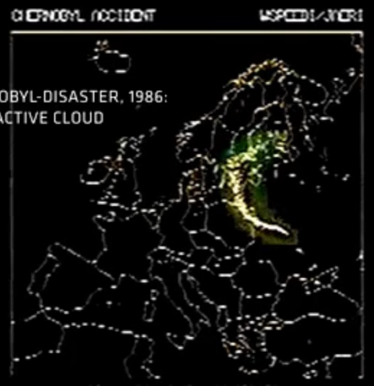
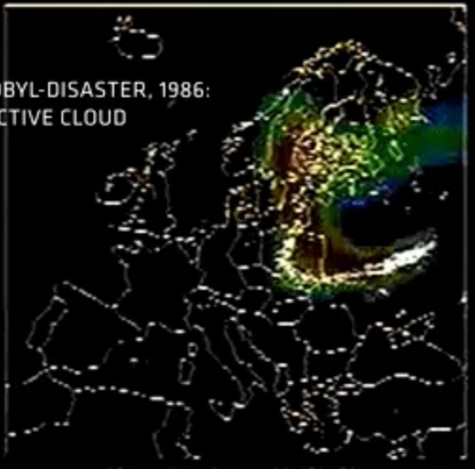
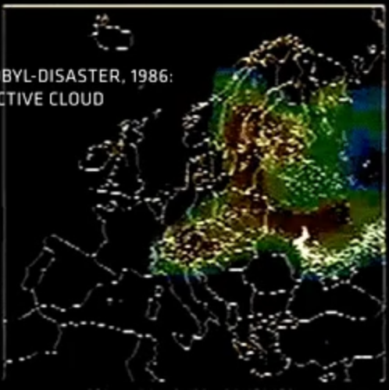
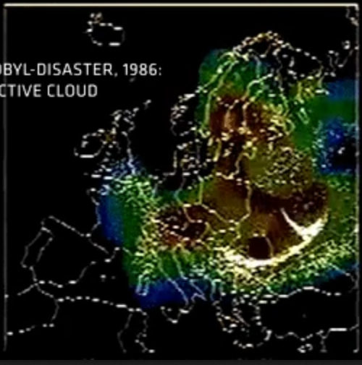
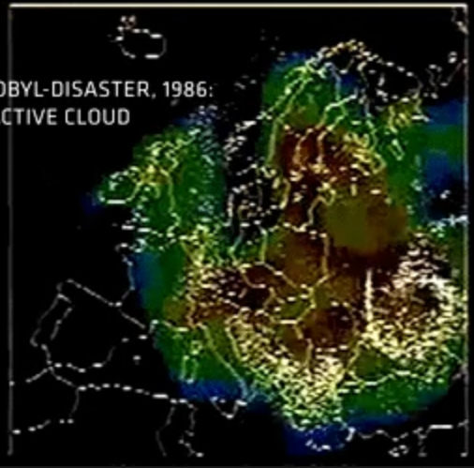
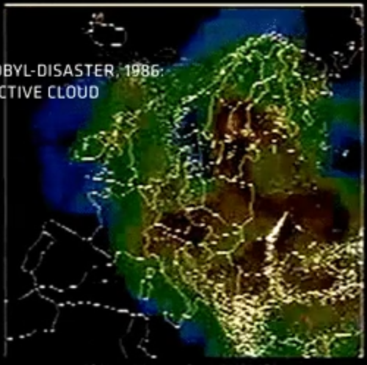
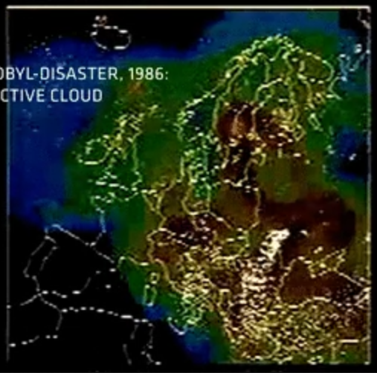
Still Screen Shots Radiation Hose
Source: https://www.reddit.com/r/MapPorn/comments/btqh67/radioactive_cloud_moving_through_europe_after_the/

Slide 3
Fundamental challenges of Dynamical Systems
Massively non-linear
Difficult to obtain a linear representation around stable and unstable fix-points.
Lack of analytical equations for complex phenomena, e.g., distributed systems, financial markets, micro-climate, autonomous driving, disease spread, or environment contamination…
Extremely high-dimensional state-space
Difficult to simulate, because every single component or event could be a state.
Limited measurements (Sparsity and/or Hidden States)
Difficult to infer next value of states given inputs (actuators and perturbations)
https://www.reddit.com/r/MapPorn/comments/btqh67/radioactive_cloud_moving_through_europe_after_the/

Slide 4
Machine Learning Control
Machine Learning techniques + Enough Data allow to approximate the system dynamics and synthesize an efficient controller
Machine Learning Techniques allow to :
Approximate the System Dynamics without relying on analytic equations
Mitigate state space explosion by producing low-dimensional representations that can be used for control.
Mitigate sparsity and partially observability of states by learning models that allow to make probabilistic inference the value of states
Mitigate non-stationarity by detecting patterns of change in the data that affect the effectivity of controller

Slide 5

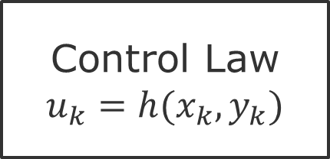

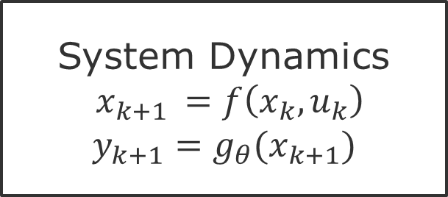

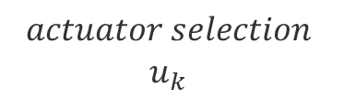
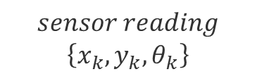
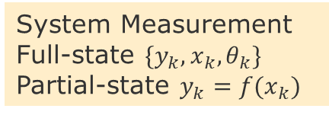
Control optimization constrained by systems dynamics
state of system at discrete time k and k+1
Disturbances
$$f\left(x_{k},u_{k}\right)=Ax_{k}+Bu_{k}$$
System Dynamics
$x_{k+1 }=f\left(x_{k},u_{k}\right)$
$$y_{k+1}=g_{θ}(x_{k+1})$$
$${actuator u}_{k}$$
$${system output y}_{k}$$
Control Law
$$u_{k}=h(x_{k},y_{k})$$
$$actuator selection$$
$u_{k}$
$$sensor reading$$
$\left\{x_{k},y_{k}, θ_{k}\right\}$
System Measurement
Full-state ${\{y}_{k},x_{k},θ_{k}\}$
Partial-state $y_{k}=f(x_{k})$

Slide 6
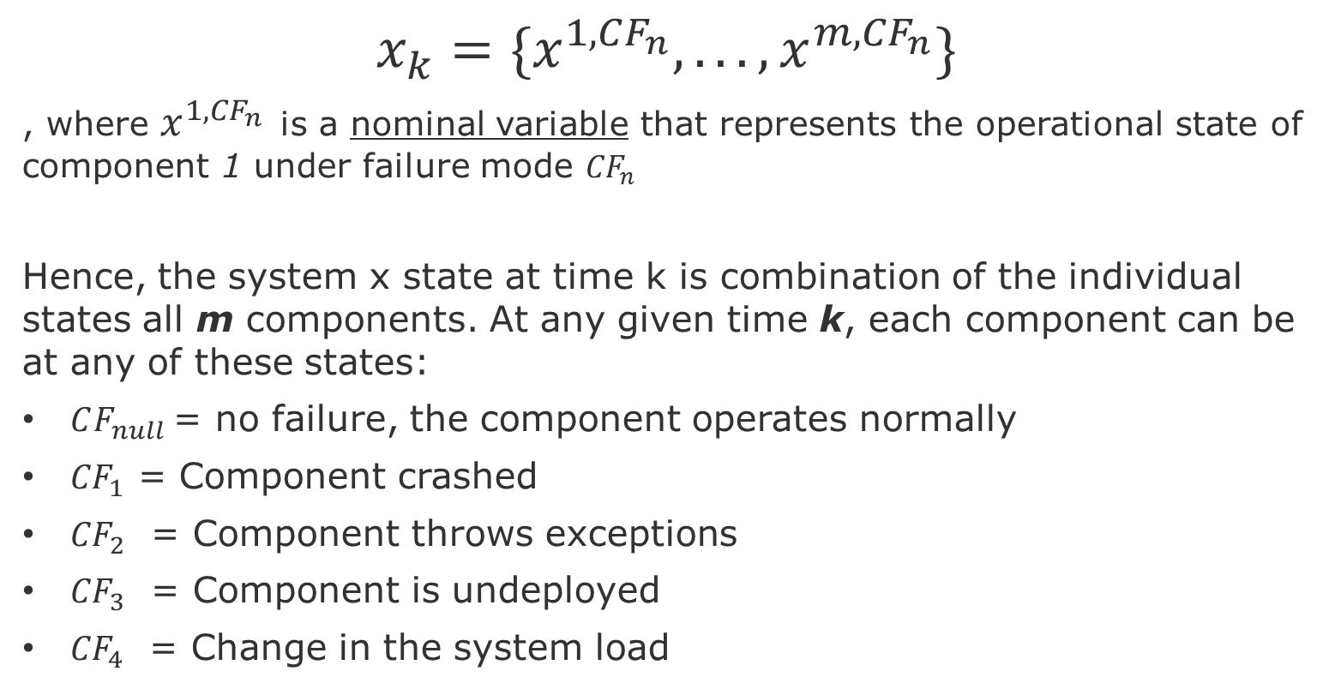
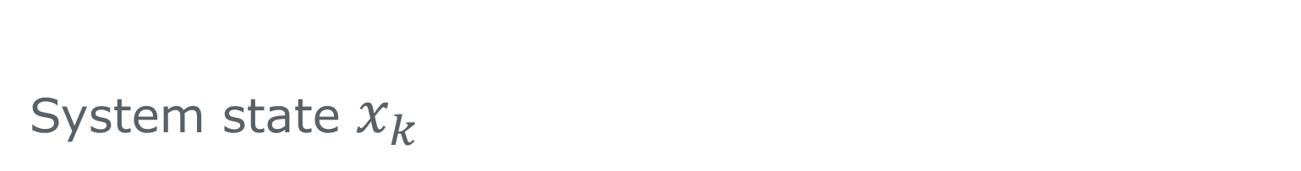
System state $x_{k}$
$$x_{k}={\{x}^{1,CF_{n}}, ... , x^{m, {CF}_{n}}\}$$
, where $x^{1,{CF}_{n}}$ is a nominal variable that represents the operational state of component 1 under failure mode ${CF}_{n}$
Hence, the system x state at time k is combination of the individual states all m components. At any given time k, each component can be at any of these states:
$CF_{null}$= no failure, the component operates normally
${CF}_{1}$ = Component crashed
${CF}_{2}$ = Component throws exceptions
${CF}_{3}$ = Component is undeployed
${CF}_{4}$ = Change in the system load

Slide 7
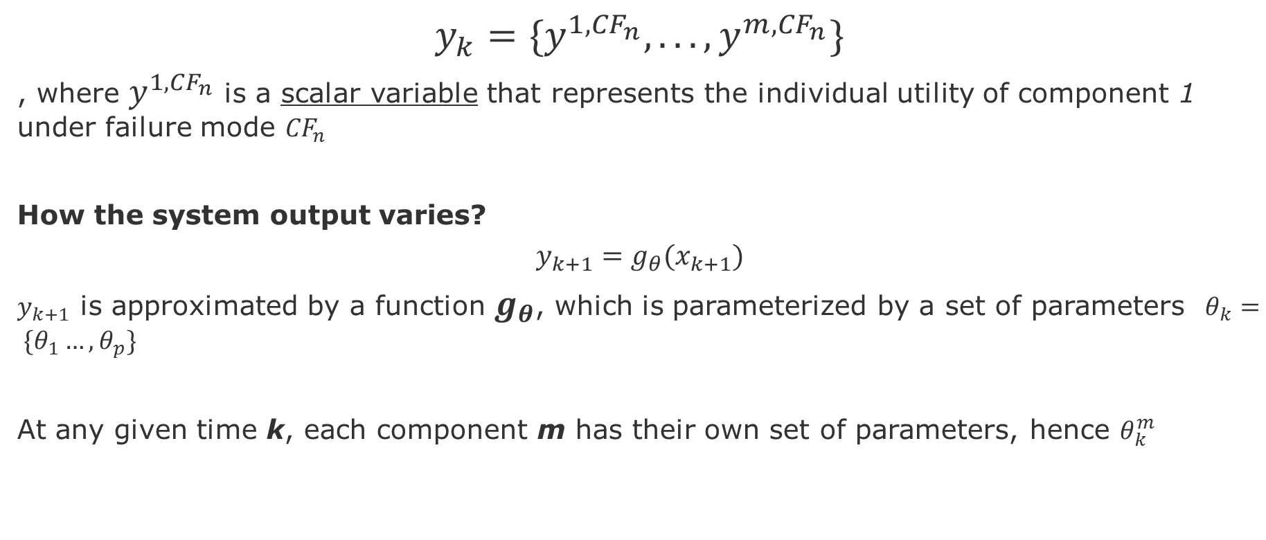
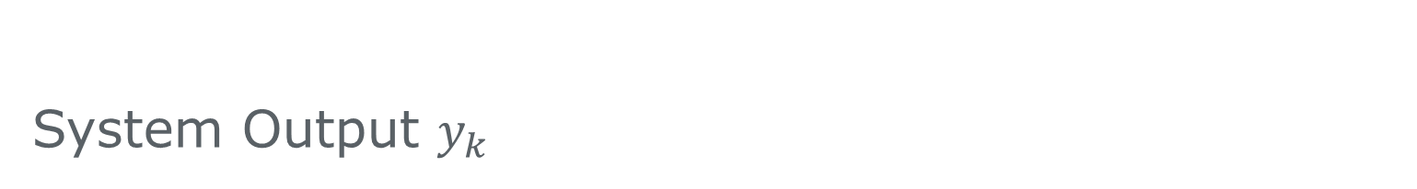
System Output $y_{k}$
$$y_{k}={\{y}^{1, {CF}_{n}}, ... , y^{m, {CF}_{n}}\}$$
, where $y^{1,CF_{n}}$ is a scalar variable that represents the individual utility of component 1 under failure mode ${CF}_{n}$
How the system output varies?
$$y_{k+1}=g_{θ}(x_{k+1})$$
$y_{k+1}$ is approximated by a function $g_{θ}$, which is parameterized by a set of parameters $θ_{k}= \{θ_{1}…,θ_{p}\}$
At any given time k, each component m has their own set of parameters, hence $θ_{k}^{m}$

Slide 8
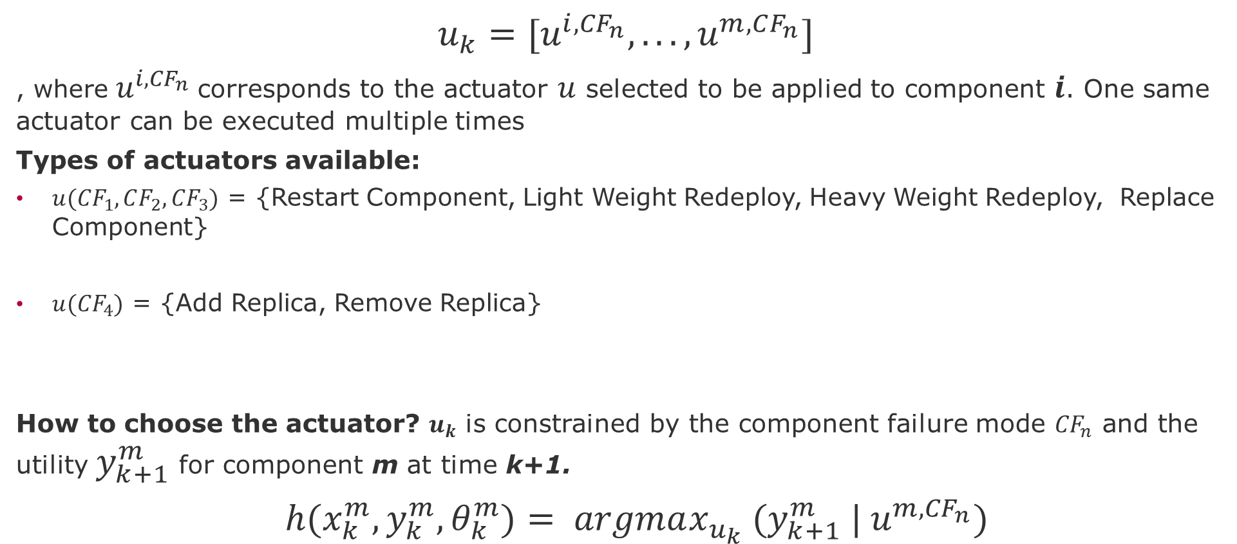

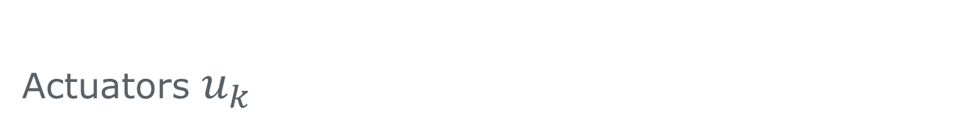



Actuators $u_{k}$
$$u_{k}={[u}^{i, {CF}_{n}}, ... , u^{m, CF_{n}}]$$
, where $u^{i, {CF}_{n}}$corresponds to the actuator $u$ selected to be applied to component $i$. One same actuator can be executed multiple times
Types of actuators available:
$u({CF}_{1},CF_{2},{CF}_{3})$ = {Restart Component, Light Weight Redeploy, Heavy Weight Redeploy, Replace Component}
$u({CF}_{4})$ = {Add Replica, Remove Replica}
How to choose the actuator? $u_{k}$ is constrained by the component failure mode ${CF}_{n}$ and the utility $y_{k+1}^{m}$for component m at time k+1.
$h(x_{k}^{m},y_{k}^{m}, θ_{k}^{m})= argmax_{u_{k}}{ (y}_{k+1}^{m} | u^{m,{CF}_{n}})$
discrete time impulse response I
$$u_{k}=I, k=0$$
$$u_{k}=0, k>0$$
$$u_{k}∈\left\{−1,+1\right\}, k=0$$
discrete time step
$$u_{k}=0, k>0$$

Slide 9
System Utility

Slide 10
Utility Drop
Utility
Utility (optimal)
CF1
Dropped U ₁
CF5
Dropped U ₂
CF1
Dropped U ₃
Time

Slide 11

Optimal Rule
Utility
Utility (optimal)
Set of repair Rules
CF1
Dropped U ₁
Mark the triggered rules
CF5
Applicable Rules
Not applicable
Dropped U ₂
CF1
Dropped U ₃
Time

Slide 12
Optimal Rule
Utility
Restart Component
Heavy Weight Redeployment
Light weight Redeployment
Replace Component
Utility (optimal)
CF1
Dropped U ₁
Add Replica
Remove Replica
CF5
Dropped U ₂
CF1
Dropped U ₃
Time

Slide 13
Optimal Rule and Utility Increase
Utility
Add Replica
Utility (optimal)
Restart
CF1
Dropped U ₁
Add Replica
Replace
CF5
HW Redeployment
LW Redeployment
Dropped U ₂
CF1
Dropped U ₃
Time

Slide 14
Optimal Index ( Ordering of the Rules)
Reward : Utility Over Time
1-Heavy Weight Redeployment
2-Restart Component
3-Add Replica
Utility
Add Replica
Utility (optimal)
Restart
CF1
HW Redeployment
Dropped U ₁
Lost Reward
CF5
HW Redeployment
Restart
1- Add Replica
2-Restart Component
3- Heavy Weight Redeployment
Dropped U ₂
CF1
Add Replica
Dropped U ₃
Time

Slide 15
Project Plan

Slide 16
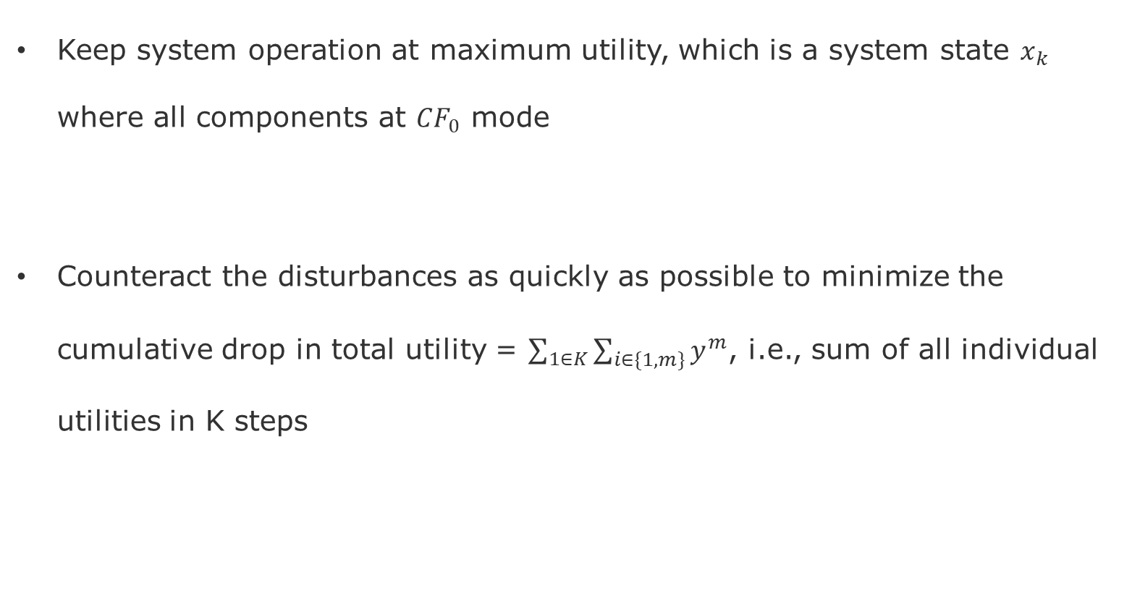
Goals
Keep system operation at maximum utility, which is a system state $x_{k}$ where all components at $CF_{0}$ mode
Counteract the disturbances as quickly as possible to minimize the cumulative drop in total utility = $\sum_{1∈K}{\sum_{i∈\{1,m\}}{y^{m}}}$, i.e., sum of all individual utilities in K steps

Slide 17
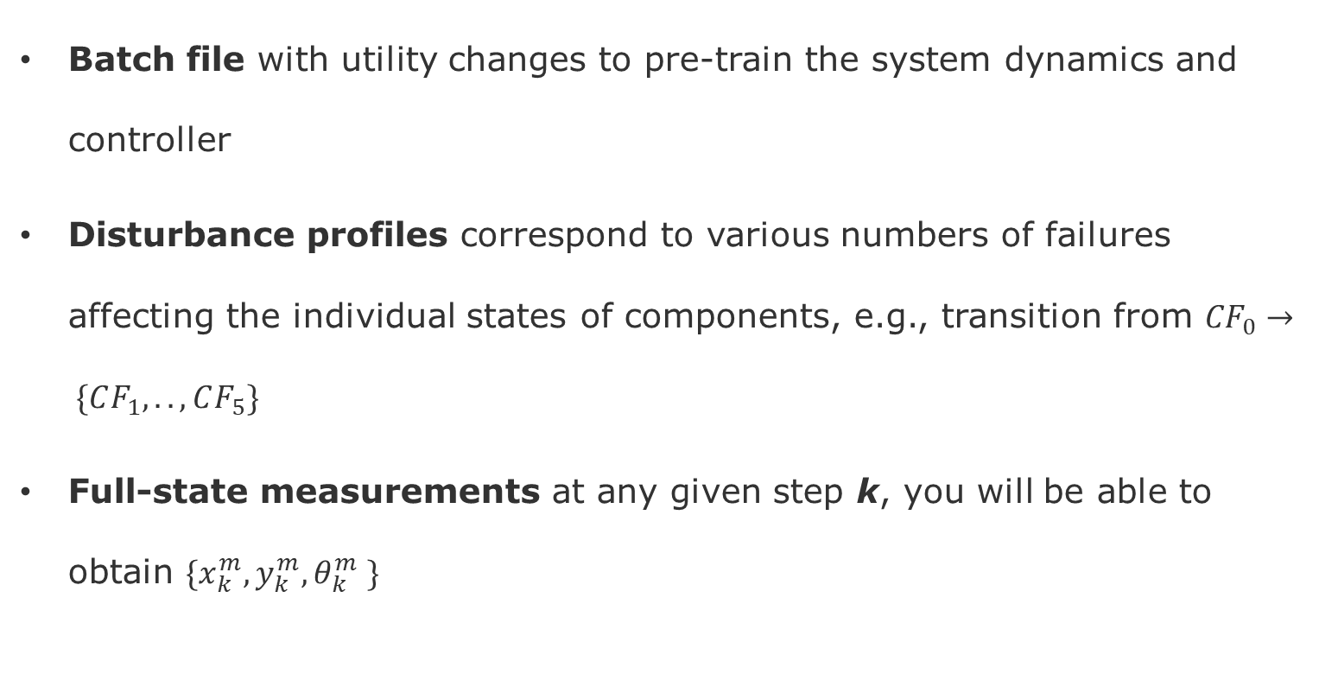
Inputs
Batch file with utility changes to pre-train the system dynamics and controller
Disturbance profiles correspond to various numbers of failures affecting the individual states of components, e.g., transition from ${CF}_{0}→ \{CF_{1},.., CF_{5}\}$
Full-state measurements at any given step k, you will be able to obtain $\{x_{k}^{m},y_{k}^{m}, θ_{k}^{m} \}$

Slide 18
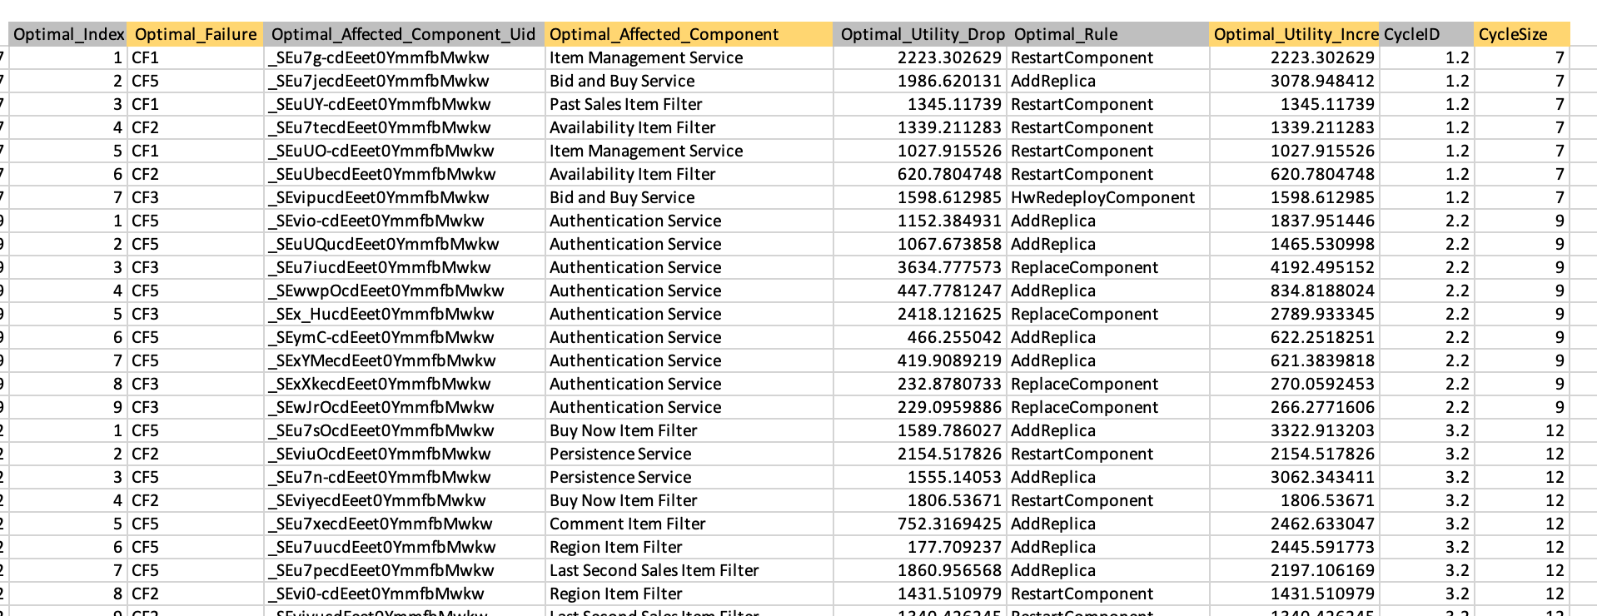
Data Used for the Implementation

Slide 19
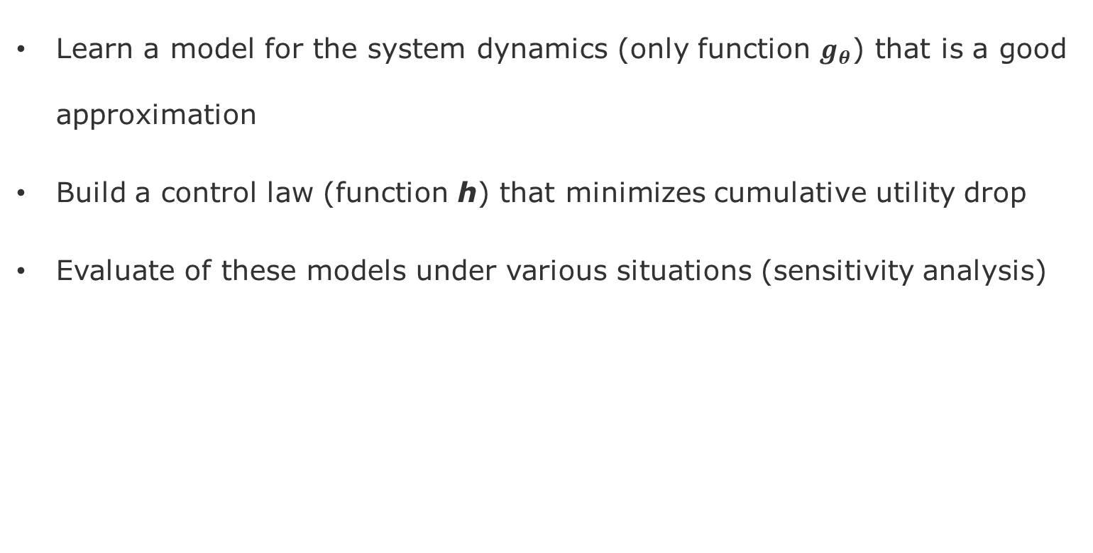
Deliverables
Learn a model for the system dynamics (only function $g_{θ}$) that is a good approximation
Build a control law (function h) that minimizes cumulative utility drop
Evaluate of these models under various situations (sensitivity analysis)

Slide 20
Project-1 - Tasks
Environment Setup
Execute mRubis system simulator Java-Java
Execute the integration Python-Java
System Identification (train a model of mRubis system)
Choose a Machine Learning algorithm)
Train a prior model with batch data
Controller Synthesis
Sample the sensors
Learn the control model/law
choose which actuators to execute and in which order
Evaluation
Level of disturbances
Sensor sampling frequency
Actuation frequency
Rationale of the Plan
Tasks 2 and 3 will rotate among you three across the projects, so everyone can work more deeply on System Identification and Controller Synthesis
However, everyone will run a separate evaluation and present their findings. This way, all of you have a chance to reflect upon the methods and architecture

Slide 21
Roadmap
Project-1
Full-State Measurements
Linear and Non-Linear System Dynamics
Project-2
Partial State Measurements
Latent Models (Failure Masking)
Project-3
Transfer-Learning of System Dynamics
Adaptive Control
Project-4
Reinforcement Learning Control
Model-Based, Model-Free versus ML-Control

Slide 22
End

